Slide 1

Employee Churn Analysis Project

Slide 2





Meet Our Awesome Team
DA8115 Asli
DA8118 Burcu
DA8127 Emre
DA8121 Hasan
Team member
Team member
Team member
Team member
DA8123 Nurdan
Team member

Slide 3
Roles and Contributions
Data Preprocessing
1
Handled missing data, encoded variables, and scaled features for model readiness.
2
Exploratory Data Analysis
Conducted EDA and visualizations to uncover key trends and patterns.
Model Building
3
Built and evaluated multiple models for performance.
4
Deployment
Deployed top-performing model via Streamlit for user-friendly predictions.
In this project, the team worked collaboratively to predict employee churn using both machine learning (ML) and deep learning (DL) techniques. The data preprocessing phase involved handling missing data, encoding categorical variables, and scaling features for model readiness. Exploratory Data Analysis (EDA) and visualizations were conducted to uncover key trends and patterns. Multiple models were built and evaluated for performance. The top-performing model was then deployed via Streamlit, offering an accessible and user-friendly interface for predicting employee churn.

Slide 4
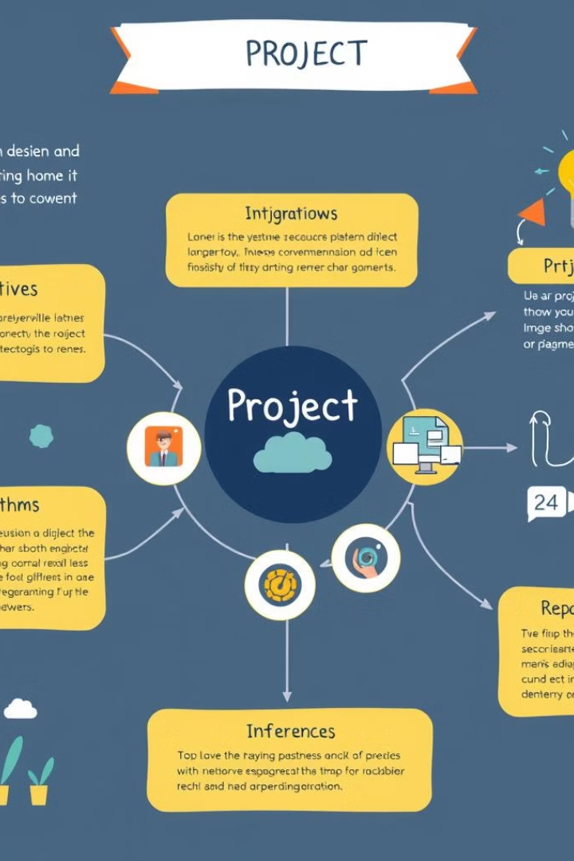
Introduction
•Project Overview •Project Objectives •Content of the Trained Data •Project Steps •Tools and Technologies •Algorithms and Method •Results and Evaluation •Inferences

Slide 5

Project Overview
1
Predict Employee Churn
2
Explore and Clean Data
3
Develop Models
Use HR data to forecast which employees may leave the organization.
Perform data exploration, cleaning, and visualization to uncover patterns.
Create classification models using various algorithms and deep learning.
4
Deploy Solution
Deploy the best model via Streamlit for real-time predictions.

Slide 6
Project Objective
Solving a Specific Problem
The main purpose of the project is to analyze why employees leave their jobs and to create early warning systems to prevent these departures.
Increasing Employee Loyalty: Identifying employees at high risk of churn and taking the necessary steps to increase their job satisfaction and commitment. Reducing Costs: Recruitment, training and adaptation processes that occur due to employee loss are quite costly. To reduce these costs, reduce the churn rate.
Protecting Critical Talent: Preventing highly skilled and strategically important employees from leaving the company.
Developing Human Resources Strategies: Optimizing human resources processes by determining the reasons for turnover tendencies based on analysis results.

Slide 7

Project Objectives
1
Identify high-risk employees
and implement strategies to boost satisfaction.
2
Minimize recruitment and training costs
by lowering churn rate.
3
Ensure retention of highly skilled and strategically vital employees

Slide 8
Content of the Trained Data
The CSV file titled "HR_Dataset" contains data about employees within a company, comprising a total of 14,999 records and 10 features. These features include both numerical and categorical data types.
Dataset Features:
1. satisfaction_level (float64): Represents the employee's job satisfaction level, with values ranging between 0 and 1.
2. last_evaluation (float64): Denotes the employee's most recent performance evaluation score, with values ranging between 0 and 1.
3. number_project (int64): Indicates the total number of projects the employee has worked on.
4. average_monthly_hours (int64): Reflects the employee's average monthly working hours.
5. time_spend_company (int64): Specifies the number of years the employee has spent with the company.
6. work_accident (int64): A binary variable indicating whether the employee has had a work-related accident (0: No, 1: Yes).
7. left (int64): Indicates the employee's status at the company (0: Still employed, 1: Left the company).
8. promotion_last_5years (int64): A binary variable indicating whether the employee was promoted in the last 5 years (0: No, 1: Yes).
9. departments (object): Specifies the department in which the employee works (categorical variable).
10. salary (object): Represents the employee's salary level, categorized as low, medium, or high.

Slide 9
Description of the Dataset Used
Dataset: The dataset used in the project consists of observations and features collected to solve a specific problem. It may contain data on topics such as customer satisfaction, disease diagnosis, or fraud detection.
Features: The dataset includes various features (variables) for each observation. These features are crucial for the model to learn and generally consist of numerical or categorical data.
Data Cleaning: This stage includes the process of eliminating missing values, outliers, and inconsistencies to improve the quality of the dataset.
Findings Obtained During the Modeling Process
Model Selection: Different machine learning algorithms (e.g., Logistic Regression, Random Forest, XGBoost) are used to determine the model with the best performance.
Training and Testing: The dataset is split into training and test sets to evaluate the learning process and generalization ability of the model. Model parameters are optimized during the training process.
Performance Metrics: Accuracy, F1 score, precision, recall, and similar metrics are used to measure the success of the model. These metrics indicate how well the model works.
Presentation of Results and Metrics
Analysis of Results: The obtained results reflect the model's performance and the characteristics of the dataset. These results are visualized through graphs and tables for better understanding.
Evaluation of Metrics: The performance metrics used are analyzed to determine the model's strengths and weaknesses. For example, a high accuracy rate indicates overall success, while a low recall value may indicate issues in predicting positive classes.
Interpretation of Results: The results are interpreted in line with the project's objectives, explaining what the findings mean in a business or social context. This provides data-based insights to decision-makers.

Slide 10
Project Steps
Exploratory Data Analysis (EDA):
Perform data visualization and statistical analysis to explore differences between churning and non-churning employees based on factors like working hours, performance, and job satisfaction.
Investigate relationships between variables and churn, such as the impact of salary levels on churn rates.
Identify and handle outliers in the dataset.
Data Preparation:
Convert categorical variables into numerical format using techniques like one-hot encoding and label encoding.
Normalize or standardize data to ensure consistent scales for model training.
Model Selection and Training:
Train multiple machine learning and deep learning models using various algorithms.
Fine-tune model parameters to improve performance.
Model Evaluation:
Calculate performance metrics such as F1-Score, Precision, Recall, AUC, and accuracy to assess model performance.
Validate the model by evaluating it on both training and testing datasets.
Interpretation of Results:
Compare the results of different models and select the best-performing one.
Save the final model and generate predictions based on it.
Model Deployment and Presentation:
Deploy the trained model to a production environment using tools like Streamlit, enabling users to input data and receive real-time predictions.
Present the model's results using visualizations, performance metrics, and insights to demonstrate its business value and impact on decision-making.

Slide 11




Tools and Technologies
Python
Scikit-learn
Main programming language for analysis and modeling.
Machine learning library for modeling.
TensorFlow/Keras
Streamlit
Deep learning applications.
interactive web applications
Scikit-Learn: A popular machine learning library in Python, offering a wide range of algorithms for supervised and unsupervised learning. It includes tools for data preprocessing, model training, validation, and evaluation. Scikit-Learn is known for its ease of use and includes models such as logistic regression, KNN, Random Forest, and XGBoost.
Key Features:
Comprehensive collection of algorithms for classification, regression, and clustering.
Data processing utilities including normalization, data splitting, and cross-validation.
User-friendly interface with strong community support.
XGBoost: A powerful library for advanced tree-based modeling.

Slide 12
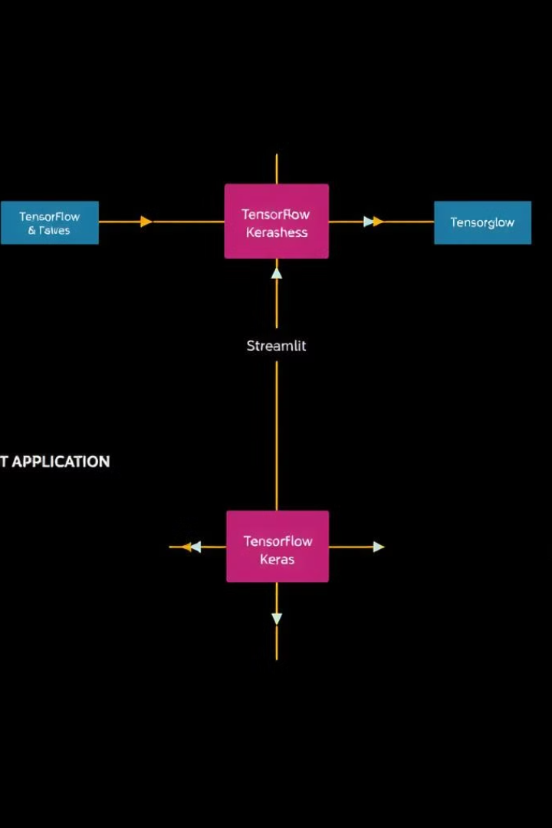
TensorFlow/Keras: TensorFlow is an open-source deep learning library developed by Google, and Keras is its high-level API that facilitates rapid development of deep learning models. Keras simplifies defining and training artificial neural networks (ANNs) and supports various architectures such as CNNs and RNNs.
Key Features:
Intuitive model building using the Keras API.
GPU/TPU acceleration for efficient handling of large datasets.
A flexible and scalable framework for deep learning.
Streamlit: A Python library that allows for the creation of interactive web applications with minimal effort. Streamlit can be used to deploy trained models and present them through user-friendly web interfaces.
Key Features:
Rapid prototype development with minimal code.
Simple interface for creating web applications.
Capability to display models, results, and data visualizations directly on the web.
These tools can be seamlessly integrated to streamline the process of building, training, and deploying both machine learning and deep learning models.

Slide 13

Models Used
Logistic Regression
K-Nearest Neighbors (KNN)
Random Forest
A simple and interpretable model ideal for binary classification problems, offering insights into the impact of different features.
An instance-based learning model that classifies new instances based on the majority vote of the nearest neighbors in the feature space.
An ensemble method that builds multiple decision trees and combines their outputs to reduce overfitting and improve prediction accuracy.
Gradient Boosting (XGBoost)
Neural Networks (Deep Learning)
Powerful ensemble methods that build models sequentially, focusing on correcting errors from previous models to improve performance.
Highly flexible and powerful models capable of capturing complex patterns and relationships in data, especially useful for large datasets with complex structures.

Slide 14
Models Used
Logistic Regression
Logistic Regression is a fundamental algorithm used for classification tasks. It optimizes model parameters using Gradient Descent to predict whether an employee will leave the job, classifying them into two categories (0: Remained, 1: Left).
Highlights:
Fast and efficient.
Produces easily interpretable results.
Outputs probabilities that indicate the likelihood of an event.
Purpose of Use:
This model is used to estimate the probability of employees leaving their jobs.
Algorithm: A statistical method specifically designed for binary classification problems.
Advantages: Simple, fast, and easy to interpret.
Disadvantages: Limited to modeling linear relationships.

Slide 15
K-Nearest Neighbors (KNN)
K-Nearest Neighbors (KNN) is a neighborhood-based classification method that makes decisions by examining the closest data points (K neighbors) to the instance being classified. It assigns classes based on distance metrics, such as Euclidean distance.
Highlights:
A non-parametric model that does not make assumptions about the data distribution.
Simple to implement and effective for small datasets.
Slower performance and higher memory usage as the dataset size increases.
Fast during model training but can be computationally expensive during the prediction phase.
Purpose of Use:
KNN is used to predict whether employees will leave the job by comparing their characteristics with those of similar employees.
Algorithm: A method that classifies data points based on the proximity of their neighbors.
Advantages: Simple to understand and implement, performs well with smaller datasets.
Disadvantages: Computationally intensive and slower on large datasets.

Slide 16
Random Forest
Random Forest is an ensemble method that combines multiple decision trees to improve classification performance. Each tree in the forest analyzes a different subset of the data, and the final prediction is determined by majority voting among the trees.
Highlights:
Resistant to overfitting by averaging multiple decision trees.
Provides accurate and well-balanced predictions.
Capable of identifying the importance of different features in the dataset.
Intended Use:
Random Forest is used to capture complex relationships and make more robust predictions when forecasting employee turnover.
Algorithm: An ensemble approach that aggregates multiple decision tree outputs.
Advantages: Reduces overfitting risk and provides high accuracy.
Disadvantages: Can be challenging to interpret and computationally intensive.

Slide 17
XGBoost
XGBoost is an advanced tree-based boosting algorithm that sequentially builds decision trees, with each new tree focusing on correcting the errors of the previous ones. It is known for its high performance and speed.
Highlights:
Produces strong results by minimizing prediction errors.
Efficiently handles large datasets with fast processing.
Includes built-in mechanisms to prevent overfitting.
Intended Use:
XGBoost is employed to achieve high accuracy and performance in predicting employee turnover, particularly in complex datasets.
Algorithm: An advanced boosting technique using decision trees.
Advantages: Fast, high-performing, and effective at preventing overfitting.
Disadvantages: Requires careful parameter tuning for optimal performance.

Slide 18
Deep Learning - Artificial Neural Networks (DL-ANN) Streamlit
Artificial Neural Networks (ANN) are a type of deep learning model known for their ability to learn and model complex relationships between inputs and outputs through a multi-layered structure. Developed using TensorFlow-Keras, ANNs are particularly effective in analyzing large datasets and capturing intricate patterns.
Highlights:
Strong Performance on Large Datasets: ANNs excel in processing and learning from extensive data, making them well-suited for large-scale problems.
Learning Complex, Non-Linear Relationships: They can model complex, non-linear relationships between variables, enhancing predictive accuracy.
Richer Feature Extraction: Deeper network layers enable the extraction and learning of more nuanced features from the data.
Purpose of Use: The goal of utilizing an ANN is to predict employee turnover with high accuracy by uncovering and modeling deeper and more complex relationships within the data.
Algorithm: Multi-layer artificial neural networks.
Advantages: Effective in handling complex data structures and achieving high success rates.
Disadvantages: Requires large datasets and can involve lengthy training times.

Slide 19
Summary Process
Data Analysis Performed on the Dataset
The analyses performed on the dataset include data cleaning, exploration, feature engineering, modeling, and performance evaluation. These processes are critical to increasing the accuracy of the model and understanding the patterns within the dataset. The results are interpreted to optimize business processes and contribute to data-driven decision-making processes.

Slide 20
Evaluation of Metrics and Results
1.Metrics Used
o Accuracy: The ratio of correctly predicted observations to the total observations. It is used to quickly assess overall performance.
o Precision: Indicates how many of the observations predicted as positive are actually positive. High precision shows that false positives are low.
o Recall: The ratio of correctly predicted positive observations to all actual positive observations. High recall shows how well the model captures the positive class.
o F1 Score: The harmonic mean of precision and recall. It is used to balance precision and recall, especially when both are important.
o Average Precision (AP) Score: Measures the area under the precision-recall curve. It is used to better evaluate model performance on imbalanced datasets.

Slide 21
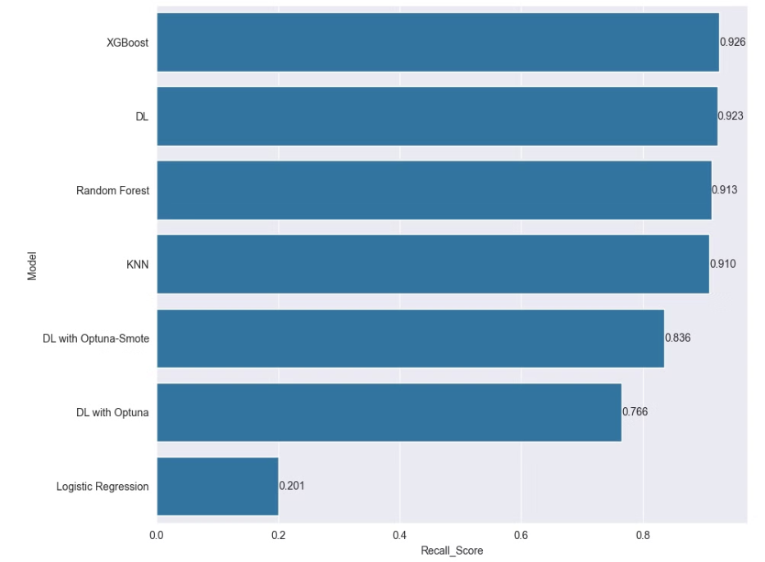
Evaluation of Metrics
XGBoost DL and Random Forest gave best results of recall scores.

Slide 22
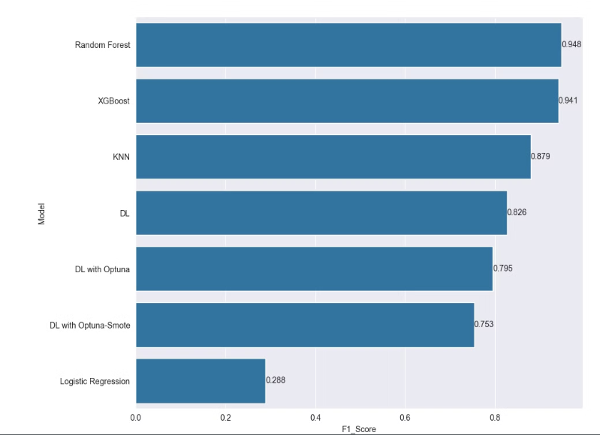
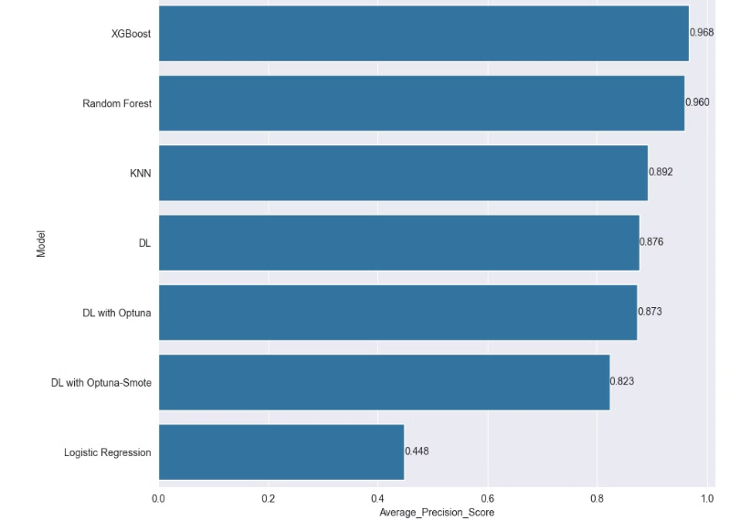
Evaluation of Metrics
Random Forest XGBoost and KNN gave best scores of F1 Score.
Random Forest XGBoost and KNN gave best scores of Precision Score.

Slide 23
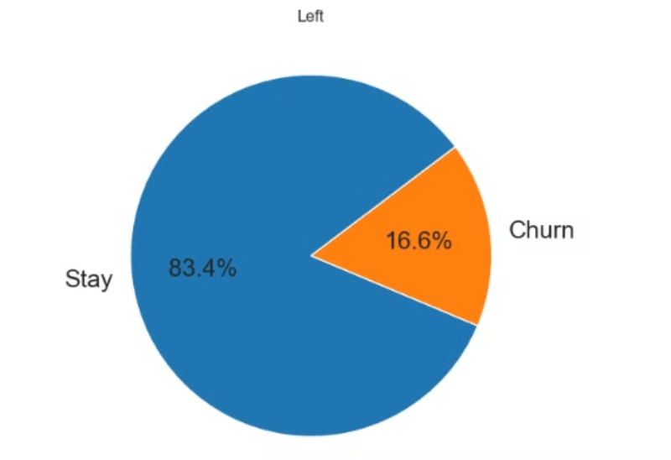
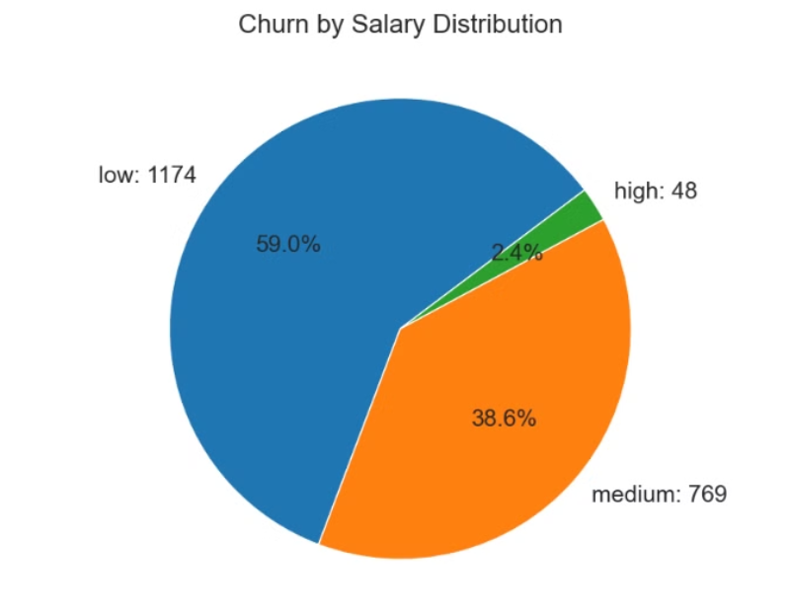
Evaluation of Visualization
16.6% of employees left the company.
Of those who left, 59% were on low salaries, 38.6% on medium salaries and 2.4% on high salaries.

Slide 24
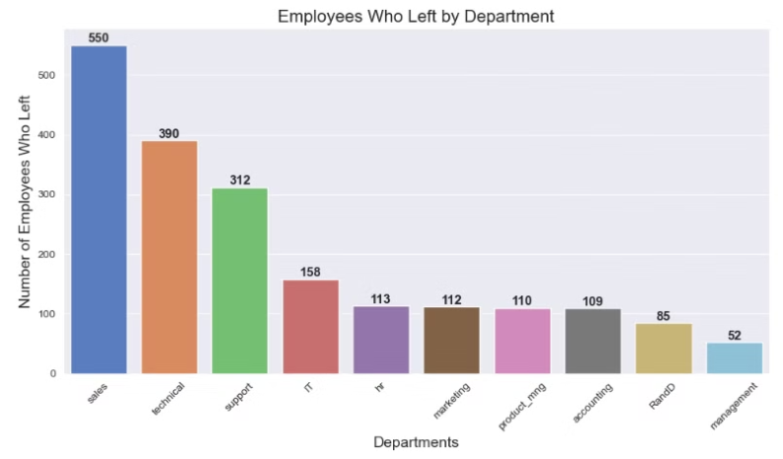
Evaluation of Visualization
Number of departmental allocations. Sales had the most departures.

Slide 25
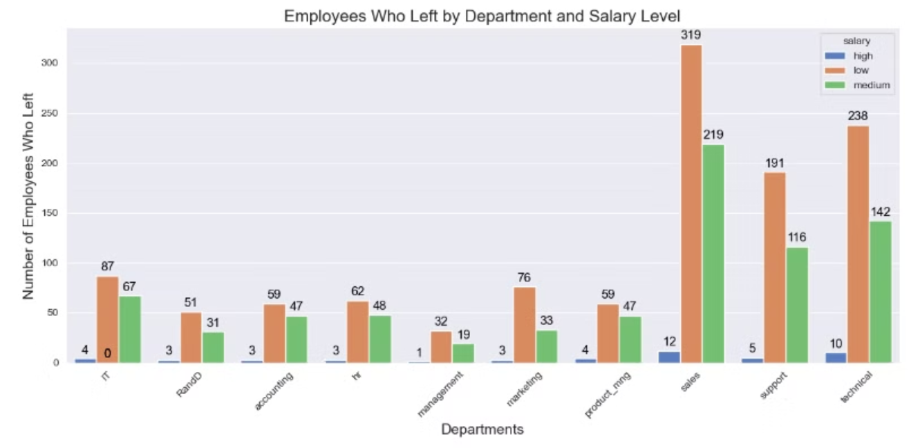
Evaluation of Visualization
Most of those separated by department are low-paid. More people leave Sales, Support and Technical.

Slide 26
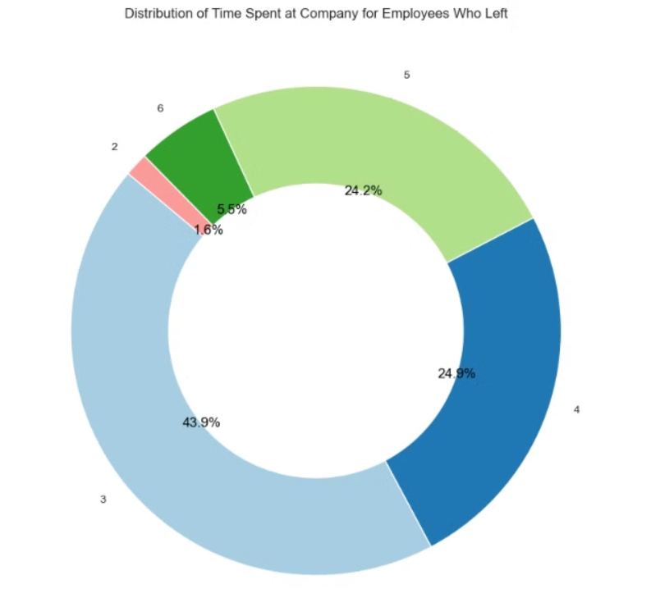
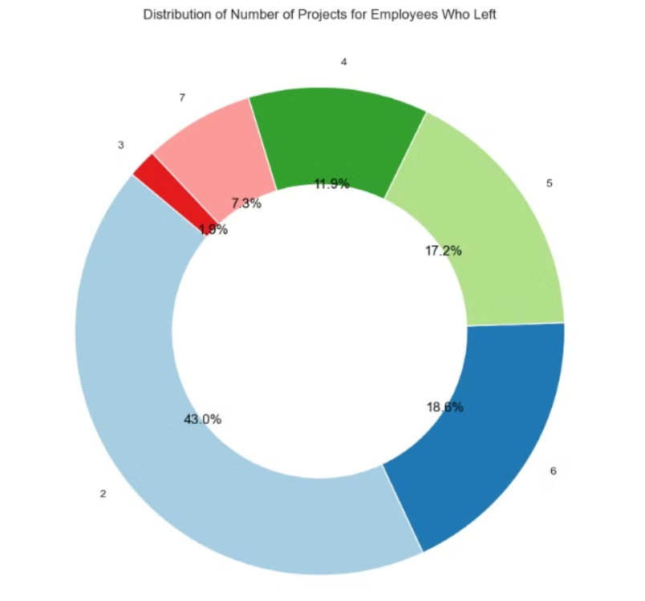
Evaluation of Visualization
Employees who have been with the company between 3-5 years have a higher rate of Churn.
Here we see the distribution of leavers according to the number of projects they have done.

Slide 27
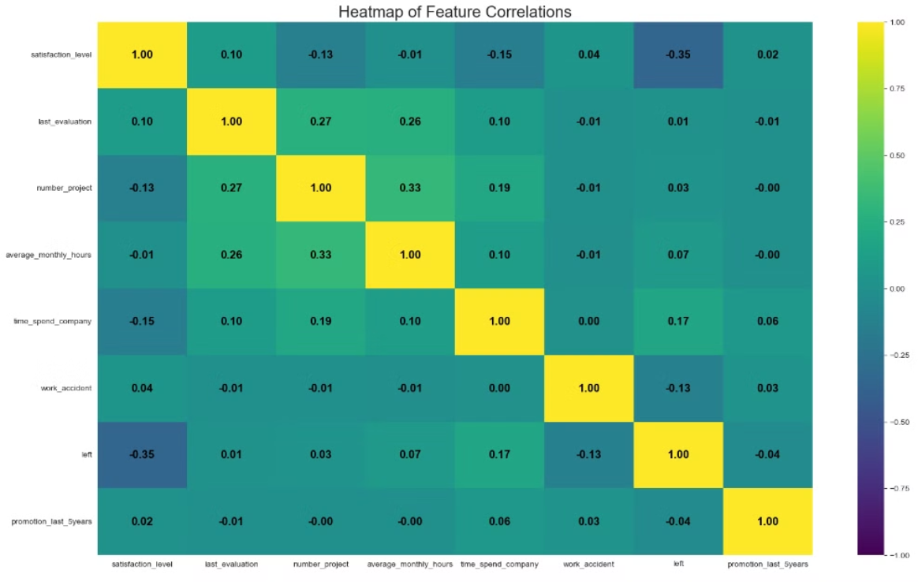
Evaluation of Visualization
The correlation ratio is shown here. A low level of satisfaction leads to leaving the company. The amount of time worked in the company is low. Number of Projects is also low. From 3 years on people started to leave.

Slide 28
Conclusion
1. Model Performance
o Recall: The recall value is 91%, indicating how well the model captures positive classes.
o Average Precision: The precision value is 96%, indicating that the model minimizes false positives.
o F1 Score: The F1 score is 95%, reflecting a balanced performance between precision and recall.
2. Complexity Analysis
o Risk of Overfitting: The model's performance is evaluated for overfitting. In cases of overfitting, the model performs very well on the training data but poorly on the test data.
o Training Time: The training time and resource usage of the model are analyzed. For example, XGBoost may require more training time compared to Logistic Regression, but it provides better performance.
the Model
The model generally performs well and offers a high accuracy rate. Additionally, the high F1 score indicates that both precision and recall are balanced.
The model generally performs well, with accuracy, precision, and recall values indicating that it works properly on the test data. However, there are areas for improvement, such as increasing the recall value. The results can be used to develop new opportunities and make strategic changes.

Slide 29
Importance, Purpose, and Outcome of the Project
· Importance: Employee churn analysis helps businesses make data-driven decisions. Data analysis enables the extraction of meaningful information from large datasets, allowing for more effective strategic decision-making.
· Purpose: The primary goal of the project is to solve a specific business or social problem using data analysis and machine learning techniques. This process requires a systematic approach to understanding and modeling datasets and using the obtained information to make more informed decisions.
· Outcome: The project has shown that the model performs well with high accuracy, precision, and recall values. The results obtained can be used to develop new opportunities and make strategic changes.

Slide 30
Inferences
What Model Results Mean for Business Value
Integrating Forecasts with Strategic Decisions
Reducing Costs
Workforce Planning
Productivity Increase
Contributions of Forecasts to the Company
Preventive Interventions:
Department Based Risk Management:
Employee Satisfaction and Loyalty Improvements:
Analysis of Mispredicted Employees
False Positives (Model Predicted Churn, But Employee Didn't Leave):
False Negatives (Model Did Not Predict Churn, But Employee Left)
Feedback for Model Development
Feature Engineering
Improving the Performance of the Model

Slide 31

THANK YOU FOR LISTENING US

